Slide 1
WyEast! Oregon Nordic Club Day Tour
Get two weekends worth of skiing in on one day. We’ll set up a car shuttle and then ski from Glacier View Sno Park (by Ski Bowl) all the way to Pocket Creek. We’ll gain ~2,500 feet, drop a little less and cover ~18 miles as we ski some of my favorite trails: Cross Town, Yellow Jacket, White River, Bennett Pass, and Meadows Creek Tie Trail. This is an advanced tour both in distance and in technical skiing required (Yellow Jacket trail is very advanced). This will be a long day with 9+ hours on the snow but this is my favorite tour at Mt. Hood.
Basic Trip Info Meeting Time: 6:00 AM Meeting Place: Gateway Transit Center Dogs are NOT Allowed on this tour Carpooling Cost: ~$15
Trip Statistics Ski Difficulty Level: ADVANCED
Distance: ~18 miles Total Climb: ~2,500 feet
Scott Diamond
scott.diamond.mail@gmail.com
503.643.6779 (mobile)

Slide 2
Cancellation
Cancellations are rare but they do occasionally happen
Please check your e-mail before driving out to carpool spot.
I’ll e-mail only if there is a cancel or change in plans, otherwise the trip is on.

Slide 3
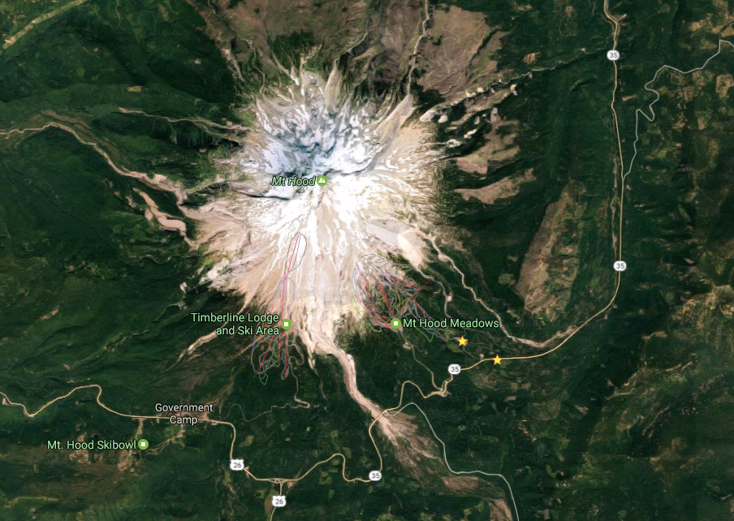
Tour Starting Point
We carpool from Gateway but we start drop a car at Pocket Creek Sno Park and drive to the tour start at from Glacier View Sno Park

Slide 4
Estimated Timing It is always hard to predict how long a tour will take. Obviously it depends on skiing ability and snow conditions. Below is my estimate.
6:00 AM Departure from Gateway
7:30 AM Car Drop at Pocket Creek (then drive to Glacier View Sno Park)
8:30 AM Start Skiing
0:00 Glacier View
2:45 Start Yellow Jacket
4:00 Lunch stop on Yellow Jacket at Salmon River crossing
6:00 White River Sno Park
7:30 Bennett Pass Sno Park
8:20 Teacup
9:30 Pocket Creek!
6:00 PM Finish Skiing (9+ hours of skiing)
7:30 PM back at Gateway
Note that if you need to rent skis you’ll need to rent them prior to the trip. It takes quite a while to rent and it doesn’t work to split the group and try and regroup when renting on the way
Notes:
Timing for 2017 with Hilary
5:45 – Depart Gateway
7:24 – Leave Pocket
8:00 – Start skiing
9:40 – West Leg Road (1:40)
10:15 – Start Yellow Jacket (2:15)
12:00– Lunch at Salmon (3:00)
12:44 – White River SP (4:45)
2:00 – Bennet pass (6:00)
2:45 – Teacup (6:45)
3:43 – Pocket (7:45)
0:00 Glacier View
22:15 Start Yellow Jacket
3:00 Lunch stop on YJ at Salmon River crossing
4:45 White River Sno Park
6:00 Bennett Pass Sno Park
6:45 Teacup
7:45 Pocket Creek!

Slide 5
Difficulty Rating Scale
5 (advanced)
5
5
4
4
4
3
3
3
2
2
2
1
1
1
0 (novice)
0
0
Technical Skiing Ability
Skiing Fitness
Isolation/Risk

Slide 6
Appropriate Skis for this Tour
Given the length of this tour, you want the lightest weight skis you can get away with. But we do ski on the Yellow Jacket obstacle course. So my advice is to bring the lightest weight pair that you think you can successfully ski the Yellow Jacket trail.
The following types of skis, listed in green, should be suitable for this tour. Please see ONC Ski Gear webpage for more information on equipment.
Skate Ski
Competitive Cross Country/Track Ski
Light touring ski (only issue is Yellow Jacket)
Backcountry Ski (typically metal edged)
Telemark Ski
AT (Advanced Touring) or Randonee Ski
The above recommendations depend on the skill of the skier. Please contact me if you have questions.

Slide 7
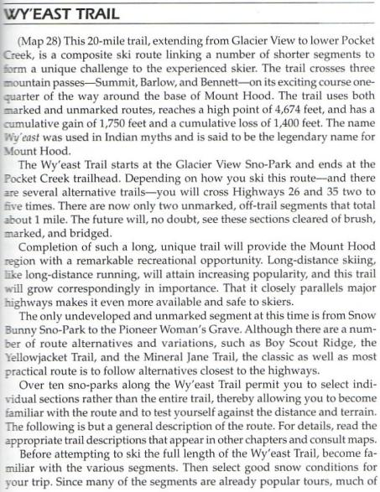
Note we are modifying the route listed in Klindt’s book but his description gives a feel for the tour

Slide 8
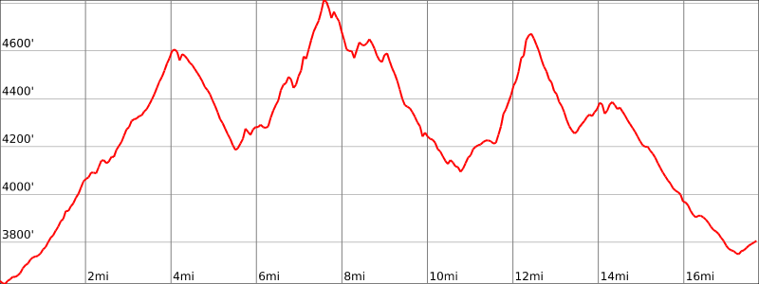
Salmon River Crossing
Bennett Pass
Top West Leg
Teacup

Slide 9
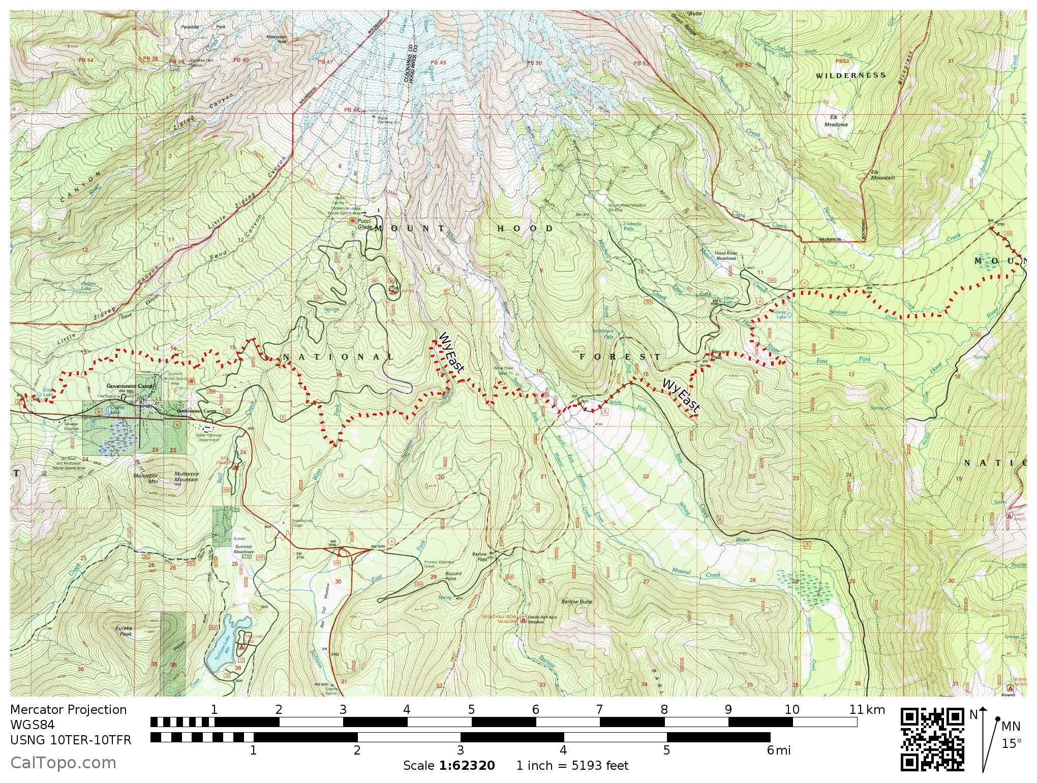

Slide 10
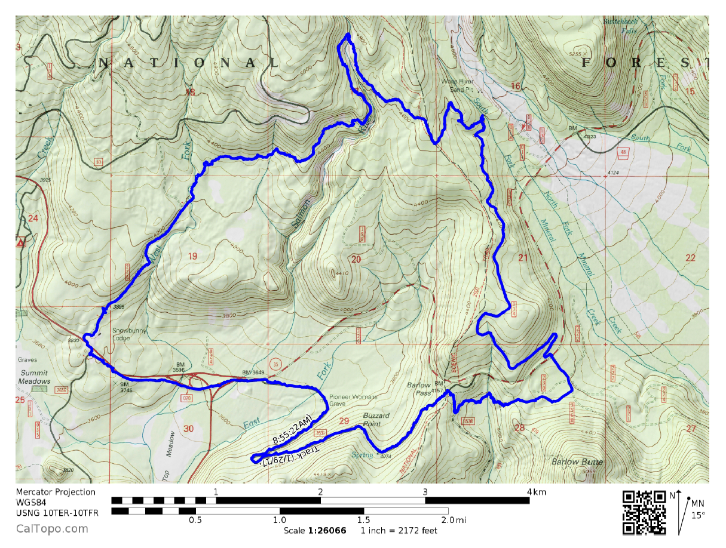
GPS Map Link (you are not required to bring a GPS but I’m making this available)
GPS Track on GPSies
The link above allows you to easily download a GPX file or you can use their iPhone app
GPS Track on CalTopo
The link above allows you to easily print a map of our route
Sample map from CalTopo

Slide 11
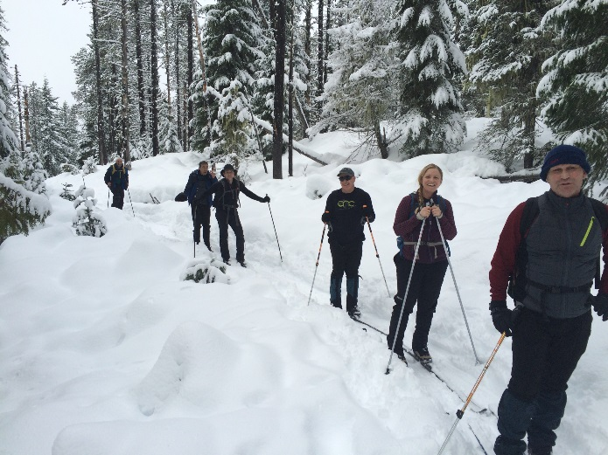
Detailed Route Write-up
This is a great tour. In one tour you sweep through most of the cross country ski areas on Hood. You have climbs, drops, narrow trails and flat plains on open roads. Some of everything. This is my favorite tour on Hood but it is also a tough tour. The Yellow Jacket trail can feel like a never ending obstacle course and you climb pass after pass. By the time the day is done you will definitely be ready to stop skiing for the day.
The start is friendly enough. You start at the Glacier View Sno-Park (across from Ski Bowl) and work your way on the Cross Town trail. This trail is pretty straightforward but you do climb as you wind you way to West Leg and then up West leg road. Mentally this section can be tough since you’ve just started and you wonder why you are going so slow (because of the climb)
Cross Town Trail

Slide 12
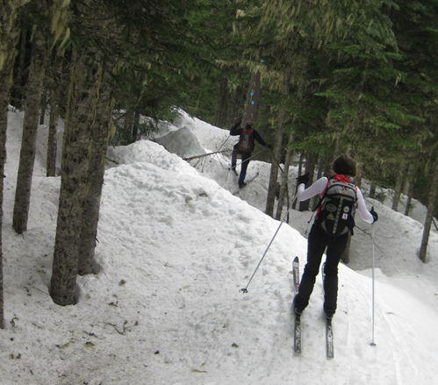
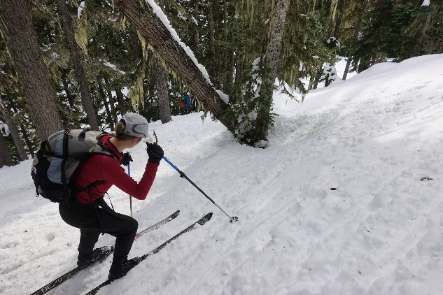
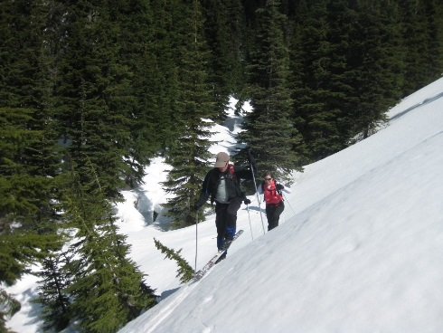
Detailed Route Write-up
Leaving West Leg you get on the Tie trail and have a nice down hill until you turn on the West Yellow Jacket trail. That is when it gets tough. The trail climbs steadily and there are number of stream crossing or small obstacles to work you way over. To make it worse, most of the route is tree covered so the snow is often crusty or blocky.
Eventually though you reach the tour highpoint, the Salmon river crossing. Another obstacle course but you make it across. There is a wonderful open spot with spectacular views of Mt Hood. Stop and have some food.
Drop down with some technical skiing but then pop out at White River Canyon and enjoy seeing all the folks out for a day tour
Typical terrain heading up YJ
Working down to Salmon River crossing
Climbing out of Salmon river

Slide 13
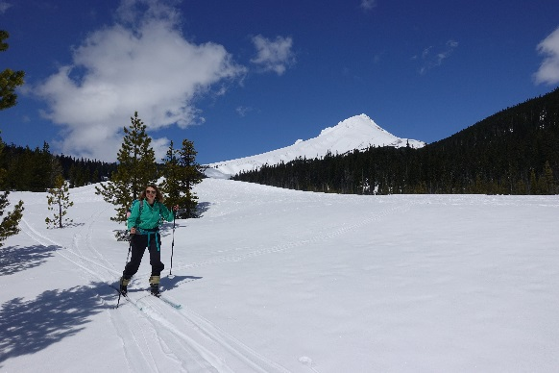
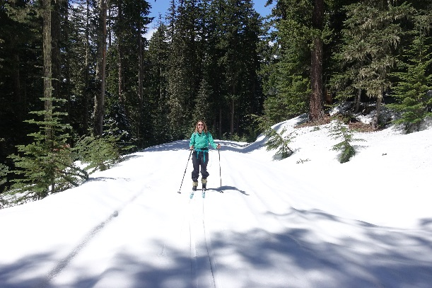
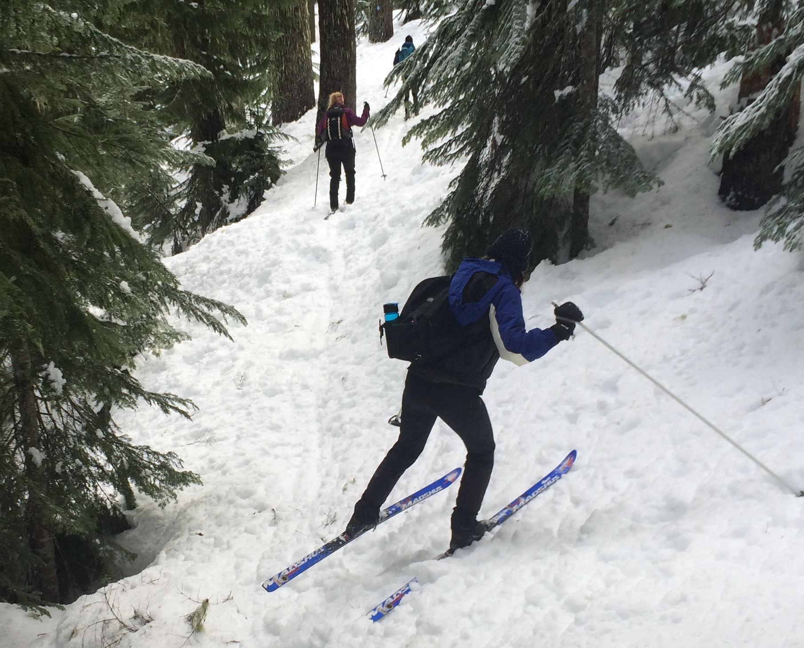
Detailed Route Write-up
The rest of the route is long but pretty straightforward. Leaving White River you cross the bridge and descend down a snowmobile road and then work your way up Bennett pass. You have to climb ~600 ft but the climb is gradual and seems to go by pretty smoothly
From Bennett you drop down the Tie trail. This is a drop and in good snow it is great but if icy it can be difficult and tedious.
Work your way to Teacup. Stop and have some tea and then zoom in on the Meadows tie trail to Pocket creek
Pat yourself on the back. Not many skiers finish this tour
Friendly White River!
Road up to Bennett Pass
Dropping off Bennett in bad snow

Slide 14
Background Info

Slide 15
ONC Carpooling Policy
If we don’t have drivers, we don’t have a trip. If you have a snow compatible car then please offer to drive. If we don’t have enough drivers then we’ll do a lottery to see who goes.
For passengers, the ONC policy is each passenger contributes 15 cents per mile. For three or more passengers, the maximum total contribution by all passengers is limited to 45 cents per mile. A typical round trip distance to Mt Hood and back is 120 miles to 160 miles = $18-$24/person

Slide 16
ONC Ski Rating
Novice level
These tours are for the inexperienced skiers. While this is not a lesson, the leader will help new skiers as much as possible. Tour length is 3-5 miles over nearly flat terrain.
Beginning/Easy level
4 to 6 Miles over gentle terrain at a pace comfortable for all participants
Intermediate level
6 to 12 miles. Terrain flat to long hills that are no steeper than found on a road (maximum 10 degrees). Moderate pace. Trail turning skills required, if there are hills.
Advanced level
> 12 miles. Terrain flat to steep hills (> 10 degrees). Moderate to fast pace. Strong turning skills required on the tours with steeper slopes.

Slide 17
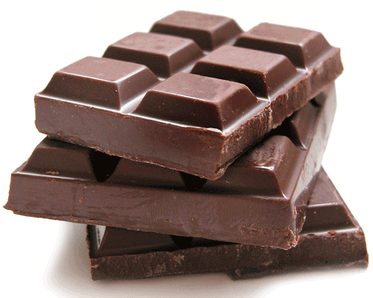
What to Bring/Gear (click links below for more info)
Ski Rental Options
What to Wear
Tour Essentials
Chocolate for trip leaders!
Note that if you need to rent skis you’ll need to rent them prior to the trip. It takes quite a while to rent and it doesn’t work to split the group and try and regroup when renting on the way

Slide 18
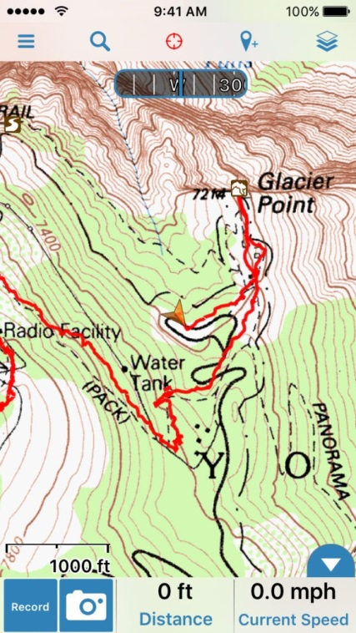
Electronic Map/GPS
Forget paper maps!
I’ve given up carrying paper maps and instead use my smartphone to see the track and where I am. This works really well.
Numerous smartphone GPS apps are available, my own favorite is Gaia ($20).
For the “ski-nerd”, there is a ski trail GPX database on the club website.
See me at one of the club meetings if you need some help using this. I’ll assist for the cost of a pint!
Sample screen shot for
Gaia iPhone Software

Slide 19
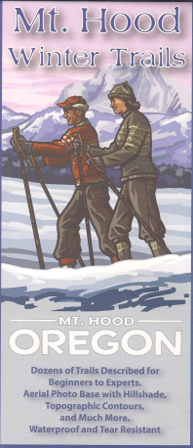
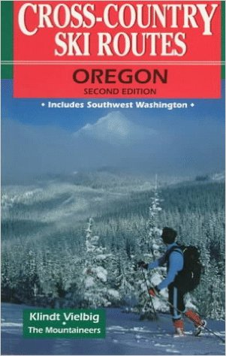
Maps/Guides
Maps and Guidebooks are great for studying trip options at home.
Note - There are always new trails being developed and the maps I have included in this packet may not be the most recent.
If you want to buy your own maps for this trip then the best one I’ve found for Mt. Hood is the 2015 Mt. Hood Winter Trails (BuyBetterMaps, Amazon or your local REI)
The best overall reference books is still Klindt Vielbig’s. This is out of print but you can still find used copies on Amazon

Slide 20
Weather Reports
Obviously the tour gets cancelled if we don’t have enough snow. Additionally if it looks like it is just going to rain on us all day then we’ll cancel. I like to use the following site to check the weather.
National Weather Service Zone Forecast. Good general description and snow level info.
Mount Hood WebCams. Amar Andalkar does a great job at pulling together all the WebCams. For day tours I like to look to see how much snow there is in Government Camp
Northwest Avalanche Center – Not applicable to the vast majority of ONC tours (since we rarely ski on or across slopes steep enough to avalanche)

