Slide 1
Pocket Creek & Bennett Pass ONC Tour This route combines the Pocket Creek and Bennett Pass tours into one. We start at Pocket creek, head through Teacup and then climb our way up to Bennett Pass (uggh). From there we head out past the “terrible traverse” and zip down to Pocket creek for a fast return to the cars. Most of the tour will be on trail with one exciting descent. The distance is >12 miles and we climb over 1,000 feet! Plan on being on the snow for more than six hours. Meeting Time: 8 AM Meeting Place: Gateway Transit Center
Scott Diamond
skiing@scottdiamond.com
503.643.6779 (mobile)

Slide 2
General Route Overview Distance > 12 miles
This is an advanced ski. The whole first half of the tour has quite a bit of climbing. There is a mix of road and trail skiing, and a lot of distance to cover.
If you are tired, the only bail out option will be to hitchhike back to car from Bennett pass
Climbing/Descending
Big climb from Teacup to Bennett
Big drop from past terrible traverse to pocket creek. Plan to be out skiing for most of the day

Slide 3
ONC Carpooling Policy
The contribution by each passenger is 15 cents per mile. For three ore more passengers, the maximum total contribution by all passengers is limited to 45 cents per mile.
For this tour, typical round trip distance to Bennett pass and back is 120 miles = $18/person

Slide 4
Level of this Ski: Advanced Rating due to climbing/descending and length of tour
Novice level
These tours are for the inexperienced skiers. While this is not a lesson, the leader will help new skiers as much as possible. Tour length is 3-5 miles over nearly flat terrain.
Beginning/Easy level
4 to 6 Miles over gentle terrain at a pace comfortable for all participants
Intermediate level
6 to 12 miles. Terrain flat to long hills that are no steeper than found on a road (maximum 10 degrees). Moderate pace. Trail turning skills required, if there are hills.
Advanced level
> 12 miles. Terrain flat to steep hills (> 10 degrees). Moderate to fast pace. Strong turning skills required on the tours with steeper slopes.

Slide 5
Estimated Timing
8:00 AM Departure from Gateway
Bathroom stop on the way at Summit
9:45 AM Park at Pocket Creek Sno Park
10:15 AM Start Skiing
4:00 PM Finish Skiing
6:00 PM back at Gateway

Slide 6
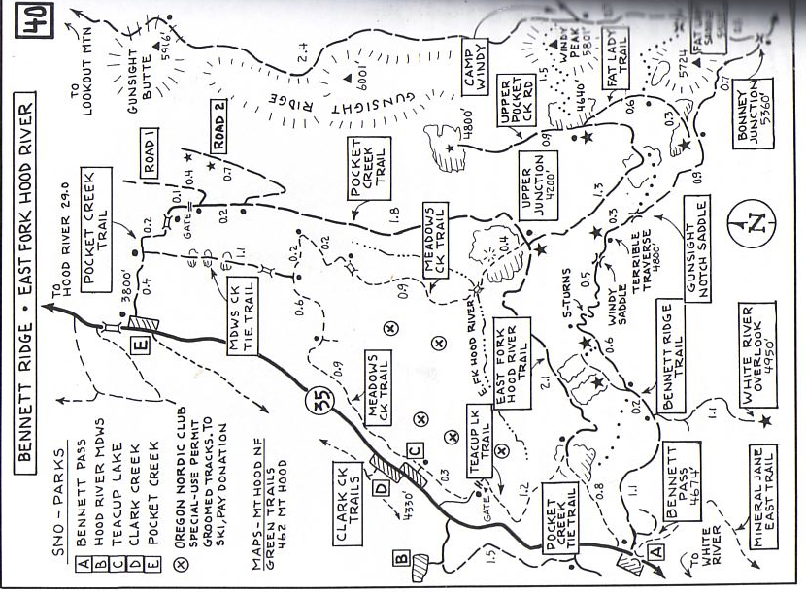
F
S

