Slide 1
Bennett Pass the Hard Way Oregon Nordic Club Day Tour
Distance 8-10 miles with 1,500 to 2,000 feet of climbing.
For those tired skiing the out-and-back on Bennett pass, this is a challenging variant which turns it into a loop tour. We start out with an exciting and often difficult drop down to Pocket Creek on the Pocket Creek Tie trail. After surviving that we have a couple miles of pleasant road touring on a flat road at the base of Bennett ridge. Eventually though we run out of room and take the totally inappropriately named “Fat Lady Trail” up 1,000 feet of climbing until we hit Bennett ridge trail . Then it gets exciting as we cross the famed “Terrible Traverse”, S-curves, slog uphill and finally a gentle downhill finish to the sno-park.
This tour has a mix of road and trail skiing. Good fitness is required and intermediate level turning for trail sections and S-curves. Please do not sign up for this tour if you do not meet these requirements.
Basic Trip Info Meeting Time: 8:00 AM Meeting Place: Gateway Transit Center Dogs are NOT Allowed on this tour Carpooling Cost: ~$15
Trip Statistics Ski Difficulty Level: INTERMDIATE+
Distance: ~10 miles Total Climb: ~2000 feet?
Scott Diamond
scott.diamond.mail@gmail.com
503.643.6779 (mobile)

Slide 2
Cancellation
Cancellations are rare but they do occasionally happen
Please check your e-mail before driving out to carpool spot.
I’ll e-mail only if there is a cancel or change in plans, otherwise the trip is on.

Slide 3
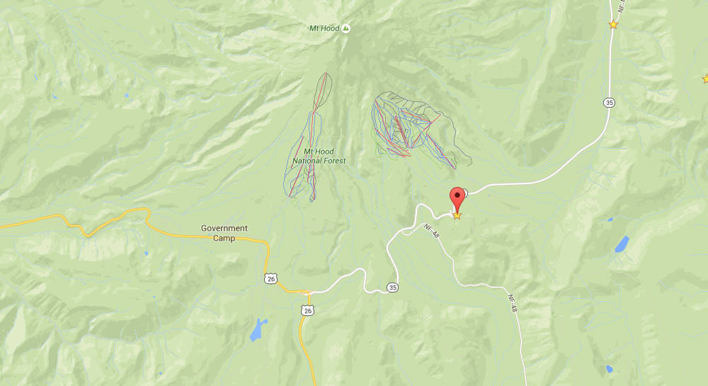
Tour Starting Point
We carpool from Gateway but we start skiing from Bennett Pass Sno-Park

Slide 4
Estimated Timing
8:00 AM Departure from Gateway
9:45 AM Park at Bennett Sno-Park
10:15 AM Start Skiing
3:15 PM Finish Skiing
5:00 PM back at Gateway
Note that if you need to rent skis you’ll need to rent them prior to the trip. It takes quite a while to rent and it doesn’t work to split the group and try and regroup when renting on the way

Slide 5
Difficulty Rating Scale
5
5
5
4
4
4
3
3
3
2
2
2
1
1
1
0
0
0
Technical Skiing Ability
Skiing Fitness
Isolation/Risk

Slide 6
Appropriate Skis for this Tour
The following types of skis, listed in green, should be suitable for this tour. Please see ONC Ski Gear webpage for more information on equipment.
Skate Ski
Competitive Cross Country/Track Ski
Light touring ski
Backcountry Ski (typically metal edged)
Telemark Ski
AT (Advanced Touring) or Randonee Ski
The above recommendations depend on the skill of the skier. Please contact me if you have questions.

Slide 7
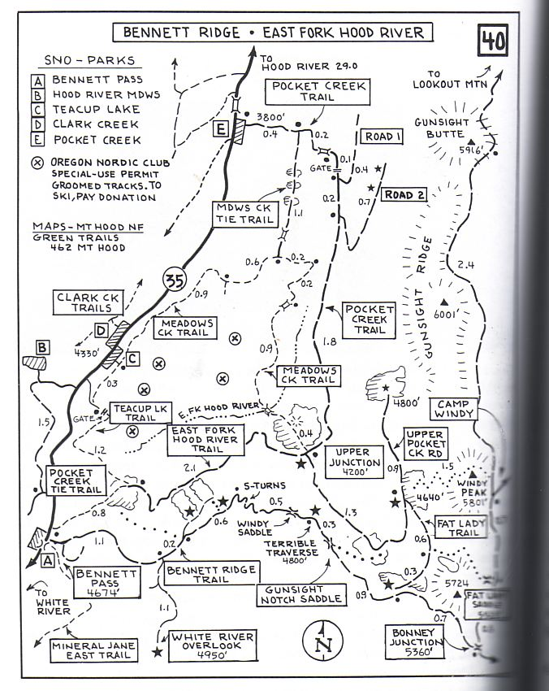
Maps are from Klindt’s book
S
F

Slide 8
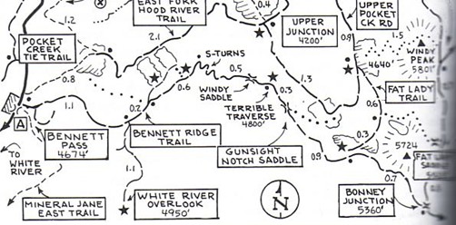
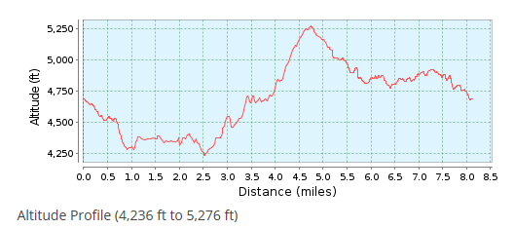
S
F

Slide 9
Estimated Ski Timing
0:00 Start Skiing Bennett Pass (4675 ft)
0:45 Junction Teacup Lake Trail (4300 ft)
2:00 Upper Junction (Meadows Creek Trail) (4250 ft)
2:15 Finish Lunch & head up road
3:00 Start Fat Lady road (Turn at Pillory Vista Sign) (4700 ft)
3:45 Junction Bennett Ridge Trail (5270)
4:15 Base of S-Curves and view of Pocket Creek (4800)
5:00 Car at Bennett Pass (4675)

Slide 10
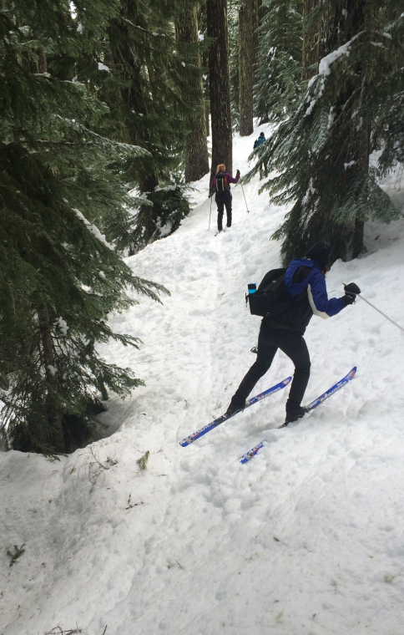
Detailed Route Info Distance 8-10 miles with 1,500 to 2,000 feet of climbing
This is a solid intermediate cross country ski. It has a good mix of trail/road, climbing and distance.
We start at Bennet Pass at ~4,650 feet and get on the Tie trail. This is a narrow trail and we drop about 400 feet vertically to 4,250 and the Pocket creek area
The descent down to Pocket Creek should be fun but unfortunately often the snow is poor and instead it involves sidestepping, falling and occasional swearing.
Tie trail in less than ideal conditions (which is most of the time)

Slide 11
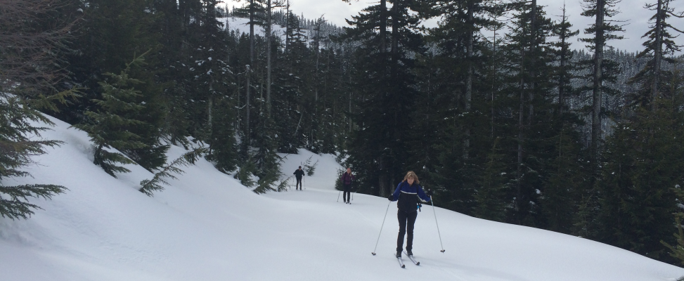
Detailed Route Info
We contour along a road staying relatively flat . We take this road a few miles until we get to the “corner” of the basin at ~4,200 feet.
Now we climb. We climb up 1,000 feet on a logging road. This logging road is also known at “Fat Lady Trail” (so named by no woman skier ever)
After much effort we work our way up to the Bennett Pass Ridge trail and hit the ridge at 5,200 feet.
Skinny lady working up the gentle “fat lady trail”

Slide 12
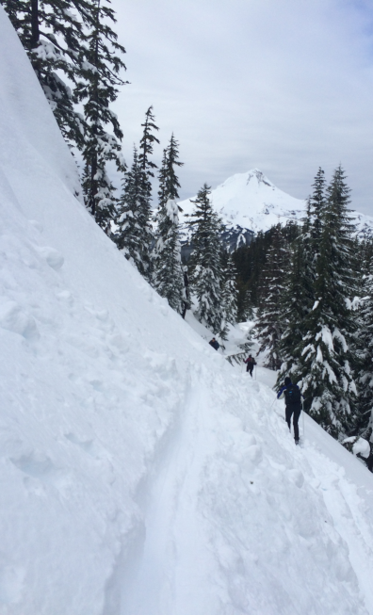
Detailed Route Info
This is the far point and now we head back towards Bennett Pass and lose ~500 feet in the process
It is all road tour coming back but the road is often filled with drifts and we have some famous Mount Hood ski sections to cross including the famed “Terrible Traverse” and S-curves.
The last ½ mile or so in is easy and downhill. That part makes a pleasant finish.
Note: If the Terrible Traverse is too dangerous then we’ll have to backtrack. Total mileage would then be ~12 miles. I think this option is unlikely.
The famed “Terrible Traverse”

Slide 13
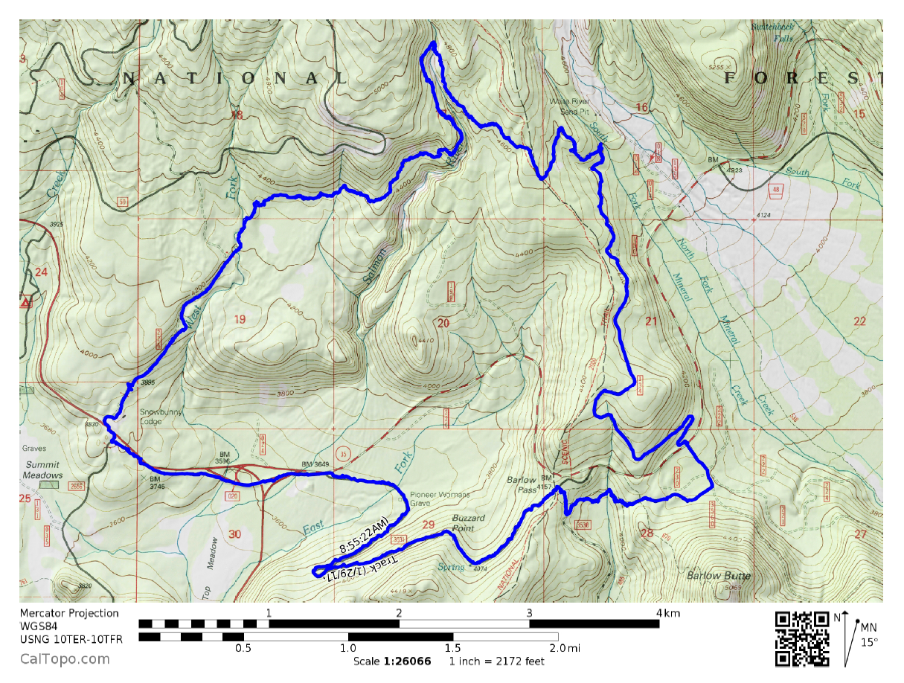
Topographic Map and GPS Track (you are not required to bring a GPS but I’m making this available)
Bennet Pass Loop GPS Track on CalTopo
The link above allows you to easily print a map of our route
Sample map from CalTopo

Slide 14
Background Info

Slide 15
ONC Carpooling Policy
If we don’t have drivers, we don’t have a trip. If you have a snow compatible car then please offer to drive. If we don’t have enough drivers then we’ll do a lottery to see who goes.
For passengers, the ONC policy is each passenger contributes 15 cents per mile. For three or more passengers, the maximum total contribution by all passengers is limited to 45 cents per mile. A typical round trip distance to Mt Hood and back is 120 miles to 160 miles = $18-$24/person

Slide 16
ONC Ski Rating
Novice level
These tours are for the inexperienced skiers. While this is not a lesson, the leader will help new skiers as much as possible. Tour length is 3-5 miles over nearly flat terrain.
Beginning/Easy level
4 to 6 Miles over gentle terrain at a pace comfortable for all participants
Intermediate level
6 to 12 miles. Terrain flat to long hills that are no steeper than found on a road (maximum 10 degrees). Moderate pace. Trail turning skills required, if there are hills.
Advanced level
> 12 miles. Terrain flat to steep hills (> 10 degrees). Moderate to fast pace. Strong turning skills required on the tours with steeper slopes.

Slide 17
What to Bring/Gear (click links below for more info)
Ski Rental Options
What to Wear
Tour Essentials
Chocolate for trip leaders!
Note that if you need to rent skis you’ll need to rent them prior to the trip. It takes quite a while to rent and it doesn’t work to split the group and try and regroup when renting on the way

Slide 18
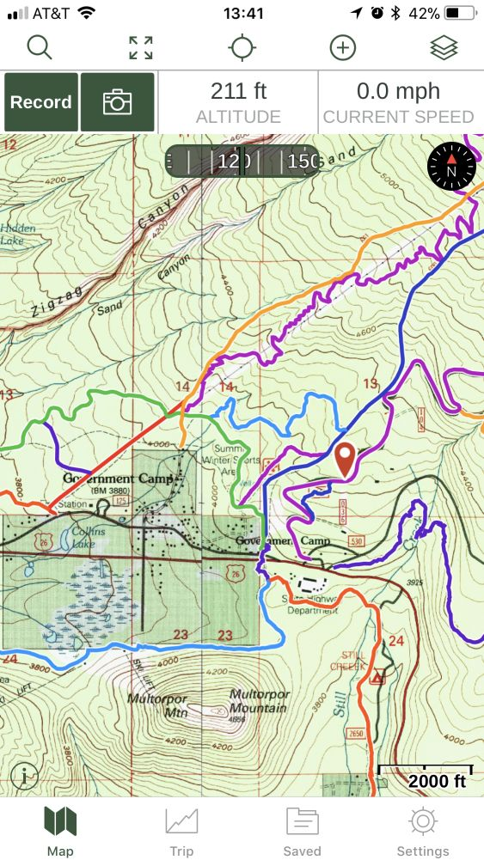
Electronic Map/GPS
Forget paper maps!
I’ve given up carrying paper maps and instead use my smartphone to see the track and where I am. This works really well.
Numerous smartphone GPS apps are available, my own favorite is Gaia ($10/year).
Additionally you can view/download full ONC track data set at CalTopo ONC Database
See me at one of the club meetings if you need some help using this. I’ll assist for the cost of a pint!
Sample screen shot for
Gaia iPhone Software

Slide 19
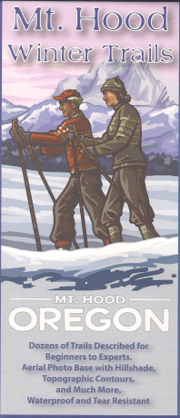
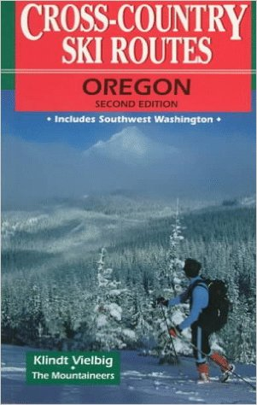
Maps/Guides
Maps and Guidebooks are great for studying trip options at home.
Note - There are always new trails being developed and the maps I have included in this packet may not be the most recent.
If you want to buy your own maps for this trip then the best one I’ve found for Mt. Hood is the 2015 Mt. Hood Winter Trails (BuyBetterMaps, Amazon or your local REI)
The best overall reference books is still Klindt Vielbig’s. This is out of print but you can still find used copies on Amazon

Slide 20
Weather Reports
Obviously the tour gets cancelled if we don’t have enough snow. Additionally if it looks like it is just going to rain on us all day then we’ll cancel. I like to use the following site to check the weather.
National Weather Service Zone Forecast. Good general description and snow level info.
Mount Hood WebCams. Amar Andalkar does a great job at pulling together all the WebCams. For day tours I like to look to see how much snow there is in Government Camp
Northwest Avalanche Center – Not applicable to the vast majority of ONC tours (since we rarely ski on or across slopes steep enough to avalanche)

