Slide 1
Still Creek Oregon Nordic Club Day Tour
Do you want to try something different? Are you OK with some uncertainty? This Saturday I’m leading the Still Creek tour. This is a point to point tour which will require a car shuttle. We’ll start at Trillium lake sno park and then drop down to Still creek road. We follow this road 13 miles as it winds it way downhill behind ski bowl and finally reaches civilization again at Rhododendron. We drop over 2,000 feet along Still Creek. If snowmobiles have run this road, then we should be able to make good time but otherwise it could be long day. Snow level is low enough that we should be able to ski all of this but there is the chance we’ll have to walk some on Still creek road at the end. Note, I’ve never led this tour, only spoken with other skiers who have done this tour.
Basic Trip Info Meeting Time: 7:00 AM Meeting Place: Gateway Transit Center Ski Difficulty Level: ADVANCED
Distance: ~14 miles Dogs are NOT Allowed on this tour Carpooling Cost: ~$20
Scott Diamond
scott.diamond.mail@gmail.com
503.643.6779 (mobile)

Slide 2
Cancellation
Cancellations are rare but they do occasionally happen
Please check your e-mail before driving out to carpool spot.
I’ll e-mail only if there is a cancel or change in plans, otherwise the trip is on.

Slide 3
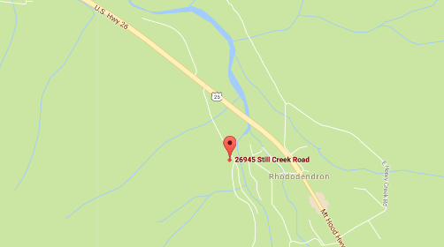
Tour Starting Point
We carpool from Gateway
But we drop ½ the vehicles off at Still Creek Road
Still Creek Road is at ~ Mile Post 43.6 on HWY 26
After Zig Zag and just before the town of Rhododendron (where Dairy Queen is)
If you see big overhead chain up sign, you’ve gone too far
Parking
We’ll drive in as far as safe. At a minimum we’ll drive in 0.3 miles but we may drive in an additional 0.8 miles to some pullouts on the side of the road
We then drive to Trillium Lake Sno-Park

Slide 4
Estimated Timing It is always hard to predict how long a tour will take. Obviously it depends on skiing ability and snow conditions. Below is my estimate.
7:00 AM Departure from Gateway
8:15 AM Drop off cars at Still Creak
9:00 Trillium
9:15 AM Start Skiing
3:30 PM? Still Creek (your estimate is as good as mine)
3:45 Leave Still Creek to Trillium
4:15 Leave Trillium back to Gateway
6:00 PM back at Gateway
Note that if you need to rent skis you’ll need to rent them prior to the trip. It takes quite a while to rent and it doesn’t work to split the group and try and regroup when renting on the way

Slide 5
Difficulty Rating Scale
5 (advanced)
5
5
4
4
4
3
3
3
2
2
2
1
1
1
0 (novice)
0
0
Technical Skiing Ability
Skiing Fitness
Isolation/Risk

Slide 6
Appropriate Skis for this Tour
The following types of skis, listed in green, should be suitable for this tour. Please see ONC Ski Gear webpage for more information on equipment.
Skate Ski
Competitive Cross Country/Track Ski
Light touring ski <- probably best for this tour
Backcountry Ski (typically metal edged)
Telemark Ski
AT (Advanced Touring) or Randonee Ski
The above recommendations depend on the skill of the skier. Please contact me if you have questions.

Slide 7
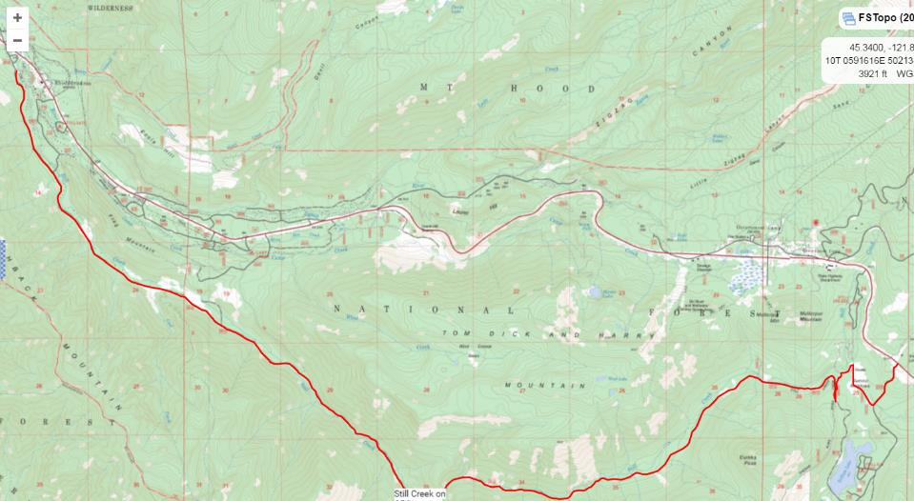
Route (see CalTopo link to download your own, high res, map)

Slide 8
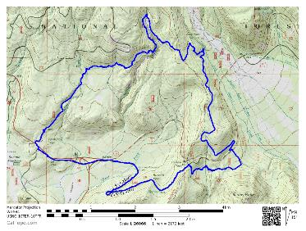
GPS Map Link (you are not required to bring a GPS but I’m making this available)
GPS Track on GPSies
The link above allows you to easily download a GPX file or you can use their iPhone app
GPS Track on CalTopo
The link above allows you to easily print a map of our route
Sample map from CalTopo

Slide 9
Background Info

Slide 10
ONC Carpooling Policy
If we don’t have drivers, we don’t have a trip. If you have a snow compatible car then please offer to drive. If we don’t have enough drivers then we’ll do a lottery to see who goes.
For passengers, the ONC policy is each passenger contributes 15 cents per mile. For three or more passengers, the maximum total contribution by all passengers is limited to 45 cents per mile. A typical round trip distance to Mt Hood and back is 120 miles to 160 miles = $18-$24/person

Slide 11
ONC Ski Rating
Novice level
These tours are for the inexperienced skiers. While this is not a lesson, the leader will help new skiers as much as possible. Tour length is 3-5 miles over nearly flat terrain.
Beginning/Easy level
4 to 6 Miles over gentle terrain at a pace comfortable for all participants
Intermediate level
6 to 12 miles. Terrain flat to long hills that are no steeper than found on a road (maximum 10 degrees). Moderate pace. Trail turning skills required, if there are hills.
Advanced level
> 12 miles. Terrain flat to steep hills (> 10 degrees). Moderate to fast pace. Strong turning skills required on the tours with steeper slopes.

Slide 12
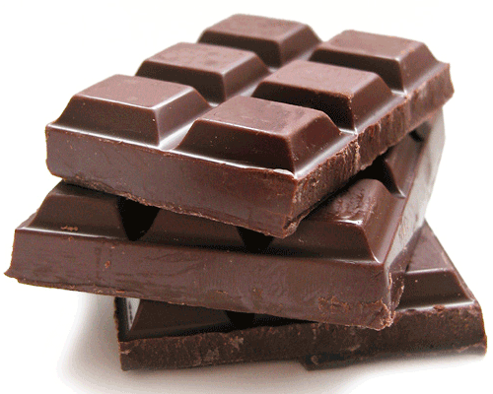
What to Bring/Gear (click links below for more info)
Ski Rental Options
What to Wear
Tour Essentials
Chocolate for trip leaders!
Note that if you need to rent skis you’ll need to rent them prior to the trip. It takes quite a while to rent and it doesn’t work to split the group and try and regroup when renting on the way

Slide 13
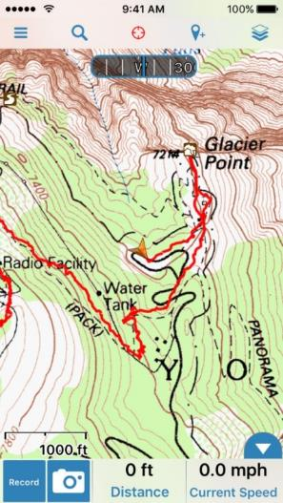
Electronic Map/GPS
Forget paper maps!
I’ve given up carrying paper maps and instead use my smartphone to see the track and where I am. This works really well.
Numerous smartphone GPS apps are available, my own favorite is Gaia ($20).
For the “ski-nerd”, there is a ski trail GPX database on the club website.
See me at one of the club meetings if you need some help using this. I’ll assist for the cost of a pint!
Sample screen shot for
Gaia iPhone Software

Slide 14
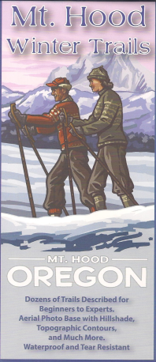
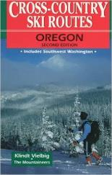
Maps/Guides
Maps and Guidebooks are great for studying trip options at home.
Note - There are always new trails being developed and the maps I have included in this packet may not be the most recent.
If you want to buy your own maps for this trip then the best one I’ve found for Mt. Hood is the 2015 Mt. Hood Winter Trails (BuyBetterMaps, Amazon or your local REI)
The best overall reference books is still Klindt Vielbig’s. This is out of print but you can still find used copies on Amazon

Slide 15
Weather Reports
Obviously the tour gets cancelled if we don’t have enough snow. Additionally if it looks like it is just going to rain on us all day then we’ll cancel. I like to use the following site to check the weather.
National Weather Service Zone Forecast. Good general description and snow level info.
Mount Hood WebCams. Amar Andalkar does a great job at pulling together all the WebCams. For day tours I like to look to see how much snow there is in Government Camp
Northwest Avalanche Center – Not applicable to the vast majority of ONC tours (since we rarely ski on or across slopes steep enough to avalanche)

