Slide 1
Turning Yellow Oregon Nordic Club Day Tour
We’ll have a full day as we take on this 12 mile advanced tour on the Yellow Jacket trail. As Klindt Vielbig says in his book “If you can ski this trail with aplomb, you may consider yourself and Advanced skier”. We’ll do our best to demonstrate aplomb. This tour starts at Trillium Sno Park and we immediately climb up and take on Yellow Jacket and head to White River. To return we won’t car shuttle but we’ll ski back on Boy Scout ridge, some rarely used roads to connect to Barlow pass. From Barlow we work our way back to Trillium Sno Park. This last section will require a short ski on the side of HWY 26. This will be a full day packed with adventure and some great skiing.
Basic Trip Info Meeting Time: 7:30 AM Meeting Place: Gateway Transit Center Ski Difficulty Level: ADVANCED
Distance: ~12 miles Dogs are NOT Allowed on this tour Carpooling Cost: ~$15
Scott Diamond
scott.diamond.mail@gmail.com
503.643.6779 (mobile)

Slide 2
Cancellation
Cancellations are rare but they do occasionally happen
Please check your e-mail before driving out to carpool spot.
I’ll e-mail only if there is a cancel or change in plans, otherwise the trip is on.

Slide 3
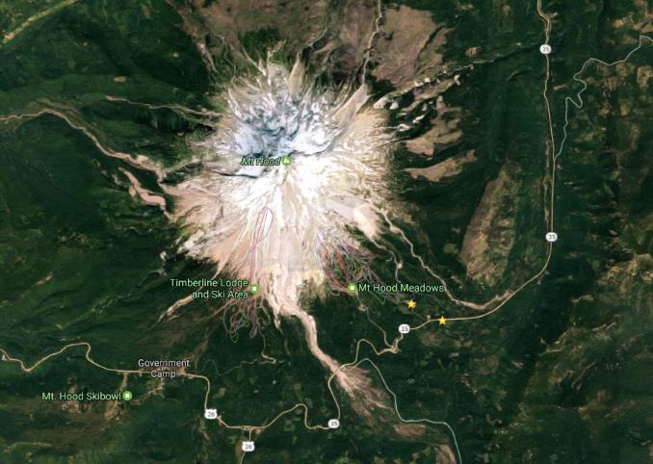
Tour Starting Point
We carpool from Gateway but we start skiing from Trillium Lake Sno-Park

Slide 4
Estimated Timing It is always hard to predict how long a tour will take. Obviously it depends on skiing ability and snow conditions. Below is my estimate.
7:30 AM Departure from Gateway
9:00 AM Park at Trillium Sno-Park
9:15 AM Start Skiing
11:30 AM Cross Salmon River
1:30 PM Panorama Dome (Boy scout Ridge)
3:00 PM Barlow Pass
4:30 PM Finish Skiing
6:30 PM back at Gateway
Note that if you need to rent skis you’ll need to rent them prior to the trip. It takes quite a while to rent and it doesn’t work to split the group and try and regroup when renting on the way

Slide 5
Difficulty Rating Scale
5 (advanced)
5
5
4
4
4
3
3
3
2
2
2
1
1
1
0 (novice)
0
0
Technical Skiing Ability
Skiing Fitness
Isolation/Risk

Slide 6
Appropriate Skis for this Tour
The following types of skis, listed in green, should be suitable for this tour. Please see ONC Ski Gear webpage for more information on equipment.
Skate Ski
Competitive Cross Country/Track Ski
Light touring ski
Backcountry Ski (typically metal edged)
Telemark Ski
AT (Advanced Touring) or Randonee Ski
The above recommendations depend on the skill of the skier. Please contact me if you have questions.

Slide 7
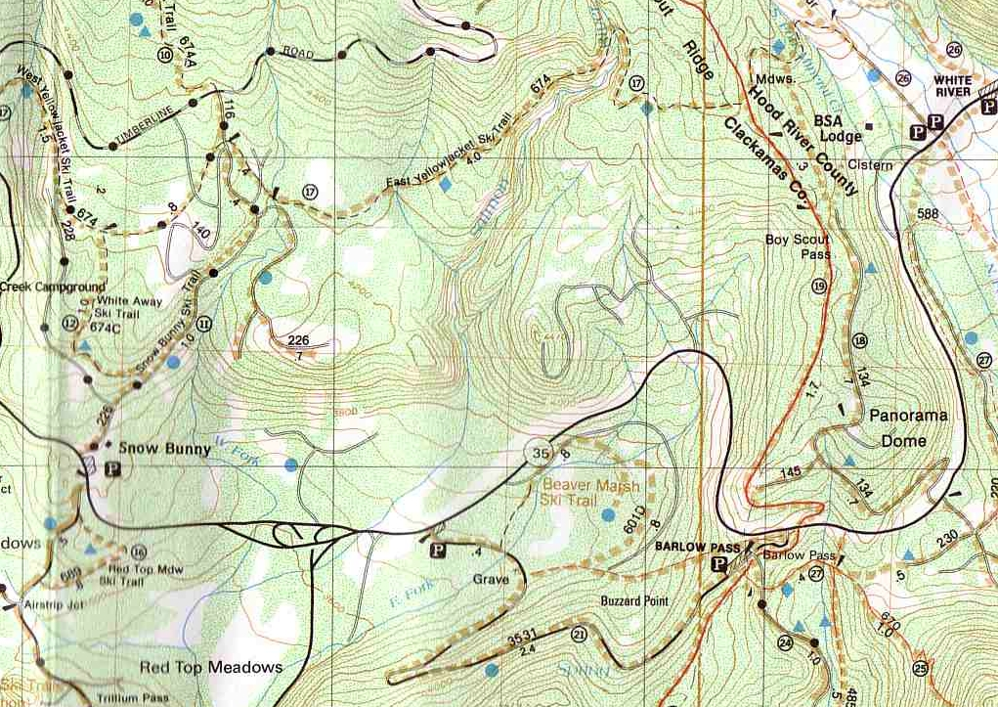
F
S
Our own trail along road

Slide 8
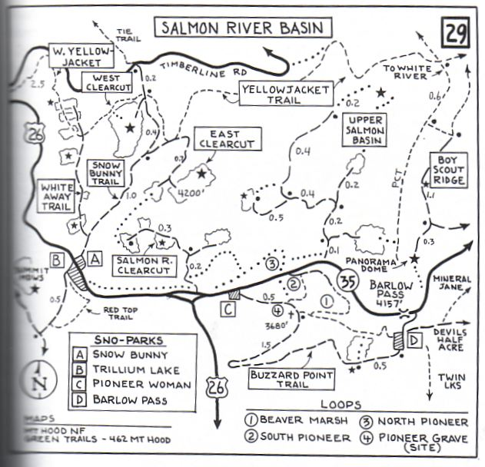

Slide 9
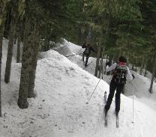
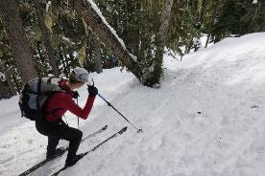
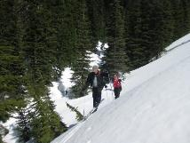
Detailed Route Write-up
This is an adventurous ski which covers a lot of terrain but at times it can seem like you are skiing an obstacle course and long for glide on your skis and a chance to make real progress.
The start on Snow Bunny trail is of course easy but once you turn on Yellow Jacket it gets tough. The trail climbs steadily and there are number of stream crossing or small obstacles to work you way over. To make it worse, most of the route is tree covered so the snow is often crusty or blocky.
Eventually though you reach the tour highpoint, the Salmon river crossing. Another obstacle course but you make it across. There is a wonderful open spot with spectacular views of Mt Hood. Stop and have some food.
Typical terrain heading up YJ
Working down Salmon
Climbing out of Salmon river

Slide 10
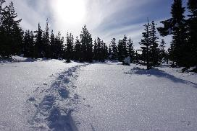
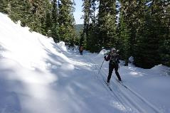
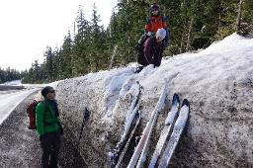
Detailed Route Write-up
As you continue on the YJ you are now descending. It is not quite as technical as before but it is still advanced. Plus going down can be harder than going up.
At the second Boy Scout ridge turn (use GPS) you take a right and head out. Again you are in trees but it is intermediate instead of advanced.
This trail dumps you on a road and you enjoy the best part of this route. The climb up to Panorama dome is a delight (scenic and often good snow).
But the best is the drop down the road to HWY 35. Zoooom!!
Crossing the HWY can be it’s own challenge. In a good snow year you need to kick steps up and down
Heading to Panorama Point
Zooming down the road
HWY 35 Crossing

Slide 11
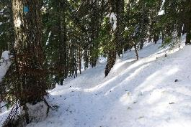
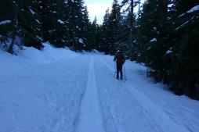
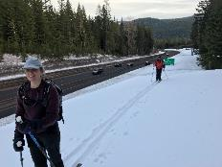
Detailed Route Write-up
After crossing HWY 35 you drop down to the Mineral Jane trail. This is pretty nice at first but it turns evil before you reach Barlow.
The trail enters the trees (crappy snow again) and you drop down a gully and climb back up. You’ve had enough of Yellow Jacket but you feel like you are on it again.
But there is salvation. After reaching Barlow you take a long, easy, all downhill road to the HWY 26/35 junction. It is a nice break.
Finally you walk across the bridge and once again exit the HWY by climbing up the snow bank
The final trek to Trillium has too much traffic noise but you make good time heading in.
Mineral Jane’s last evil challenge
The wonderful road
Almost finished!

Slide 12
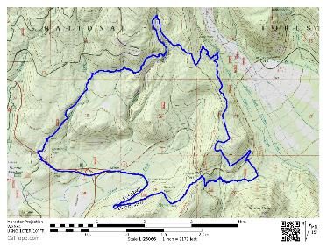
GPS Map Link (you are not required to bring a GPS but I’m making this available)
Turning Yellow Track on GPSies
The link above allows you to easily download a GPX file or you can use their iPhone app
Turning Yellow Track on CalTopo
The link above allows you to easily print a map of our route
Sample map from CalTopo

Slide 13
Background Info

Slide 14
ONC Carpooling Policy
If we don’t have drivers, we don’t have a trip. If you have a snow compatible car then please offer to drive. If we don’t have enough drivers then we’ll do a lottery to see who goes.
For passengers, the ONC policy is each passenger contributes 15 cents per mile. For three or more passengers, the maximum total contribution by all passengers is limited to 45 cents per mile. A typical round trip distance to Mt Hood and back is 120 miles to 160 miles = $18-$24/person

Slide 15
ONC Ski Rating
Novice level
These tours are for the inexperienced skiers. While this is not a lesson, the leader will help new skiers as much as possible. Tour length is 3-5 miles over nearly flat terrain.
Beginning/Easy level
4 to 6 Miles over gentle terrain at a pace comfortable for all participants
Intermediate level
6 to 12 miles. Terrain flat to long hills that are no steeper than found on a road (maximum 10 degrees). Moderate pace. Trail turning skills required, if there are hills.
Advanced level
> 12 miles. Terrain flat to steep hills (> 10 degrees). Moderate to fast pace. Strong turning skills required on the tours with steeper slopes.

Slide 16
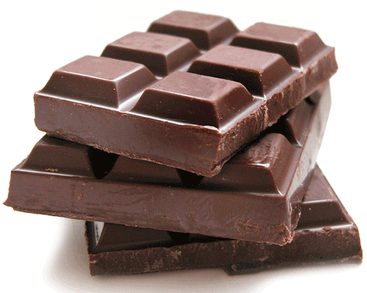
What to Bring/Gear (click links below for more info)
Ski Rental Options
What to Wear
Tour Essentials
Chocolate for trip leaders.
Note that if you need to rent skis you’ll need to rent them prior to the trip. It takes quite a while to rent and it doesn’t work to split the group and try and regroup when renting on the way

Slide 17
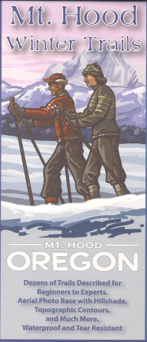
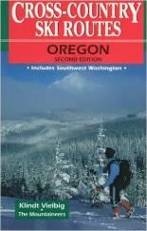
Maps/Guides
There are always new trails being developed and the maps I have images for are not the most recent. Therefore, please consider these maps to be a rough guide at best.
If you want to buy your own maps for this trip then the best one I’ve found for Mt. Hood is the 2015 Mt. Hood Winter Trails (BuyBetterMaps, Amazon or your local REI)
The best overall reference books is still Klindt Vielbig’s. This is out of print but you can still find used copies on Amazon

Slide 18
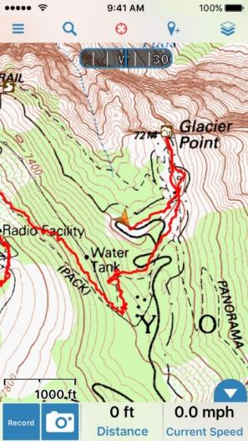
Electronic Map/GPS
I’ve given up carrying paper maps and instead use my smartphone to see the track and where I am
Numerous smartphone GPS apps are available, my own favorite is Gaia ($20).
See me at one of the club meetings if you need some help using this.
Sample screen shot for
Gaia iPhone Software

Slide 19
Weather Reports
Obviously the tour gets cancelled if we don’t have enough snow. Additionally if it looks like it is just going to rain on us all day then we’ll cancel. I like to use the following site to check the weather.
National Weather Service Zone Forecast. Good general description and snow level info.
Mount Hood WebCams. Amar Andalkar does a great job at pulling together all the WebCams. For day tours I like to look to see how much snow there is in Government Camp
Northwest Avalanche Center – Not applicable to the vast majority of ONC tours (since we rarely ski on or across slopes steep enough to avalanche)

