Slide 1
Trillium Lake and Mud Creek Ridge Oregon Nordic Club Day Tour
The snow is at low elevations this year so let’s take advantage of it and ski the longest tour we can do in the Trillium basin. We’ll do a quick loop around the lake and then head up for Mud creek loop. If we find a nice hill in the sun we’ll take a lunch break and try some Telemark turns before slogging back up to Trillium Lake Sno-Park
Basic Trip Info Meeting Time: 8 AM Meeting Place: Gateway Transit Center Ski Difficulty Level: Intermediate Dogs are NOT Allowed on this tour Carpooling Cost: $15
Scott Diamond
scott.diamond.mail@gmail.com
503.643.6779 (mobile)

Slide 2
Cancellation
Cancellations are rare but they do occasionally happen
Please check your e-mail before driving out to carpool spot.
I’ll e-mail only if there is a cancel or change in plans, otherwise the trip is on.

Slide 3
More Detailed Route Info Distance ~11 miles with 1000 feet elevation gain About 7.5 miles if we take Quarry cutoff
This is an intermediate tour. It is mostly on roads so it doesn’t take a high level of skiing ability but we’ll cover a lot of miles so you need to be fit.
The tour descends from Trillium Sno-Park and we’ll take hard right and do a loop around Trillium lake.
This is the limit of most Trillium tours but we’ll do more. We’ll push on and do the Mud Creek ridge route (7 more miles!).
We may take the quarry cutoff and we may stop somewhere and try a few turns (optional)

Slide 4
Difficulty Rating Scale
5
5
5
4
4
4
3
3
3
2
2
2
1
1
1
0
0
0
Technical Skiing Ability
Skiing Fitness
Isolation/Risk

Slide 5
Estimated Timing
8:00 AM Departure from Gateway
9:20 AM Park at Trillium Sno-Park
9:45 AM Start Skiing
3:30 PM Finish Skiing
5:30 PM back at Gateway
Note that if you need to rent skis you’ll need to rent them prior to the trip. It takes quite a while to rent and it doesn’t work to split the group and try and regroup when renting on the way

Slide 6
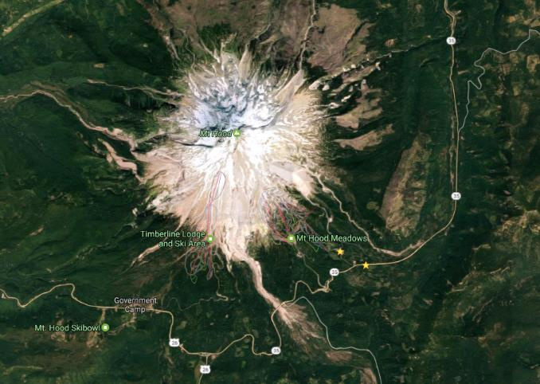
Tour Starting Point
We carpool from Gateway but we start skiing from Trillium Lake Sno-Park

Slide 7
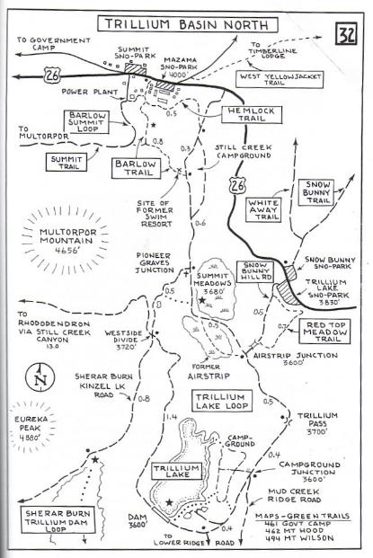
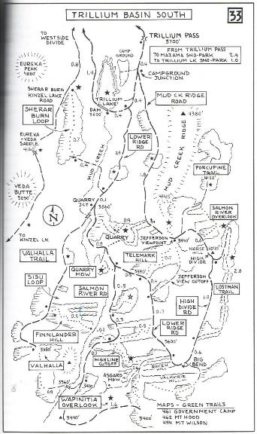
We may take this cutoff
F
S

Slide 8
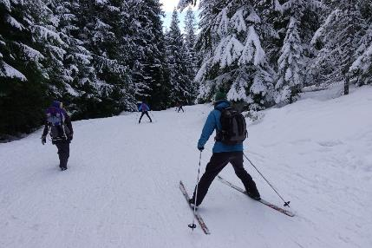
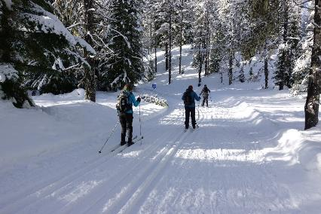
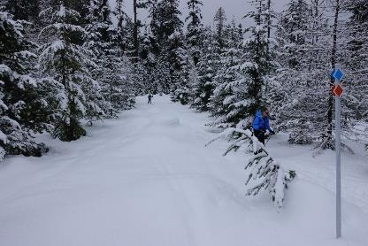
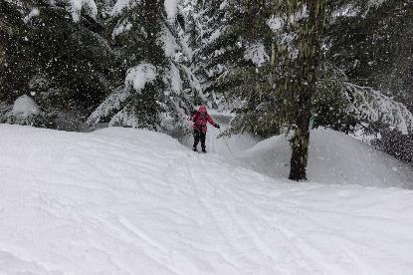
Initial descent into Trillium
Groomed tracks around lake
Working through Quarry cutoff
Quarry cutoff to Mud Creek

Slide 9
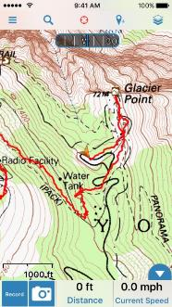
GPS Map Link
GPS Track
Trillium Mud Ridge
Trillium Mud with Quarry cutoff
I like to use the site GPSies to store track. It is a free site and they have apps for mobile devices. Better yet you can export the GPX file to your GPS or favorite GPS Software
Numerous smartphone GPS apps are available, my own favorite is Gaia ($20).
Sample screen shot for
Gaia iPhone Software

Slide 10
Background Info

Slide 11
ONC Carpooling Policy
If we don’t have drivers we don’t have a trip. If you have a snow compatible car then please drive. If we don’t have enough drivers then we’ll do a lottery to see who goes.
For passengers, the ONC policy is each passenger contributes 15 cents per mile. For three or more passengers, the maximum total contribution by all passengers is limited to 45 cents per mile. A typical round trip distance to Mt Hood and back is 120 miles to 160 miles = $18-$24/person

Slide 12
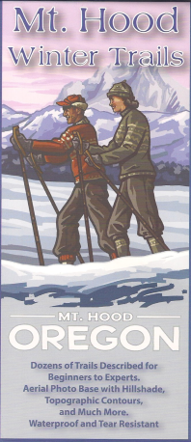
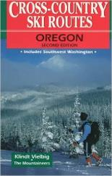
Maps
There are always new trails being developed and the maps I have images for are not the most recent. Therefore, please consider these maps to be a rough guide at best.
If you want to buy your own maps for this trip then the best one I’ve found for Mt. Hood is the 2015 Mt. Hood Winter Trails (BuyBetterMaps, Amazon or your local REI)
The best overall reference books is still Klindt Vielbig’s. This is out of print but you can still find used copies on Amazon

Slide 13
ONC Ski Rating
Novice level
These tours are for the inexperienced skiers. While this is not a lesson, the leader will help new skiers as much as possible. Tour length is 3-5 miles over nearly flat terrain.
Beginning/Easy level
4 to 6 Miles over gentle terrain at a pace comfortable for all participants
Intermediate level
6 to 12 miles. Terrain flat to long hills that are no steeper than found on a road (maximum 10 degrees). Moderate pace. Trail turning skills required, if there are hills.
Advanced level
> 12 miles. Terrain flat to steep hills (> 10 degrees). Moderate to fast pace. Strong turning skills required on the tours with steeper slopes.

Slide 14
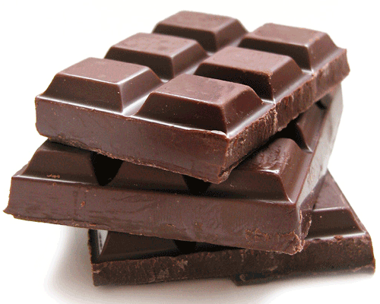
What to Bring/Gear (click links below for more info)
Ski Rental Options
What to Wear
Tour Essentials
Chocolate for trip leaders.
Note that if you need to rent skis you’ll need to rent them prior to the trip. It takes quite a while to rent and it doesn’t work to split the group and try and regroup when renting on the way

Slide 15
Weather Reports
Obviously the tour gets cancelled if we don’t have enough snow. Additionally if it looks like it is just going to rain on us all day then we’ll cancel. I like to use the following site to check the weather.
National Weather Service Zone Forecast. Good general description and snow level info.
Mount Hood WebCams. Amar Andalkar does a great job at pulling together all the WebCams. For day tours I like to look to see how much snow there is in Government Camp
Northwest Avalanche Center – Not applicable to the vast majority of ONC tours (since we rarely ski on or across slopes steep enough to avalanche)

