Slide 1
Tilly Jane and Beyond! (Cooper Spur) Oregon Nordic Club Day Tour
While thousands of downhill skiers are packed into the groomed slopes on the south and east sides of Mt Hood, we’ll take the whole north side for ourselves. If you haven’t been to Cooper Spur in the winter before, with the right snow, it is magical and definitely worth the climb.
We’ll start at Cooper Spur resort, put on skins and climb up 1,900 feet to Tilly Jane. We’ll take a lunch break there and then push on up to the open slopes above. Hopefully we’ll make it to the Cooper Spur stone shelter at 6,800 feet. Then we have fun as we demonstrate our downhill skiing prowess on the open bowls and work our way to Cloud Cap/Ghost Ridge and Wagon road trail. Finally we slog in on the road for the last couple of miles.
Distance ~10 miles with an elevation gain ~3,000feet depending on conditions.
For this tour you need to have skins, Telemark or AT skis and plastic boots. No exceptions.
Basic Trip Info Meeting Time: 6:30 AM Meeting Place: Gateway Transit Center Ski Difficulty Level: Advanced Dogs are NOT Allowed on this tour Carpooling Cost: $20
Scott Diamond
scott.diamond.mail@gmail.com
503.643.6779 (mobile)

Slide 2
Cancellation
Cancellations are rare but they do occasionally happen
Please check your e-mail before driving out to carpool spot.
I’ll e-mail only if there is a cancel or change in plans, otherwise the trip is on.

Slide 3
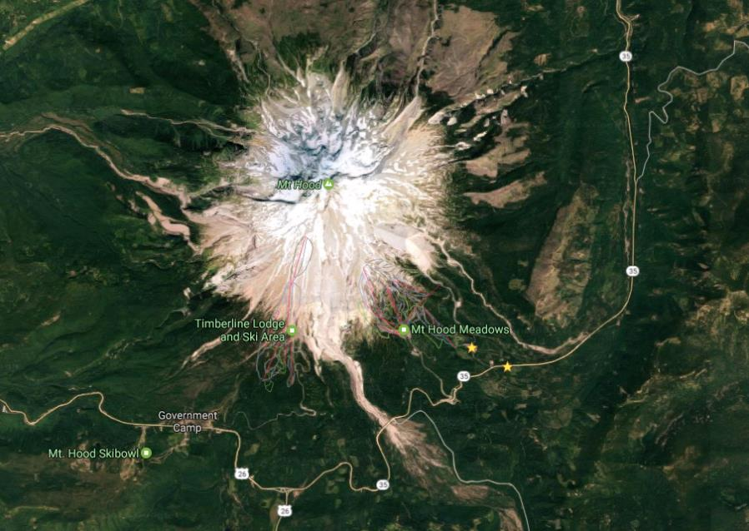
Tour Starting Point
We carpool from Gateway but we start skiing from Tilly Jane Sno-Park. This located just before final ¼ mile drive up to Cooper Spur Ski resort

Slide 4
Estimated Timing
6:30 AM Meet at Gateway
9:30 AM at Tilly Jane Sno Park(3,800 feet)
11:30 AM at Tilly Jane A-Frame (5,718 feet)
12:00 AM Continue up
1:30 PM at Stone Shelter (6,800 feet)
3:00 PM Cloud Cap (5,880 feet)
4:30 PM back at car (3,800 feet
6:30 PM back at Gateway
Note. There will be a wide range of skiing abilities. We will go down as a group and descend with the slowest skier. If you want to fly down then do not do this tour

Slide 5
Difficulty Rating Scale
5
5
5
4
4
4
3
3
3
2
2
2
1
1
1
0
0
0
Technical Skiing Ability
Skiing Fitness
Isolation/Risk

Slide 6
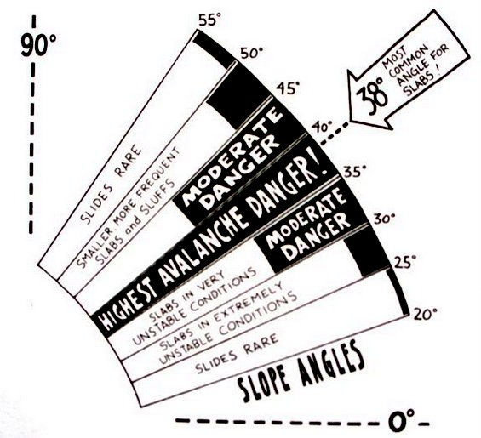
Avalanche Hazard
Understandably, I get asked about this. In general this is a very safe tour. There are a few steep sections below tree line but they are very short.
Above tree line, in the open bowls the slope is less than 20 degrees and there is little risk.
I bring a shovel but have never brought transceiver or probe poles.

Slide 7
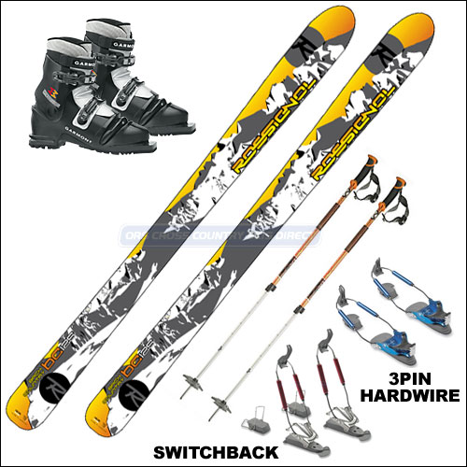
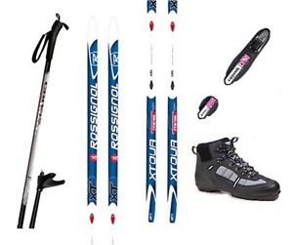
Required Equipment
Everyone should have skins, plastic boots and good turnings skis: Telemark or AT. No exceptions
NNN-BC Equipment is not suited for this tour
Showing typical Telemark package

Slide 8
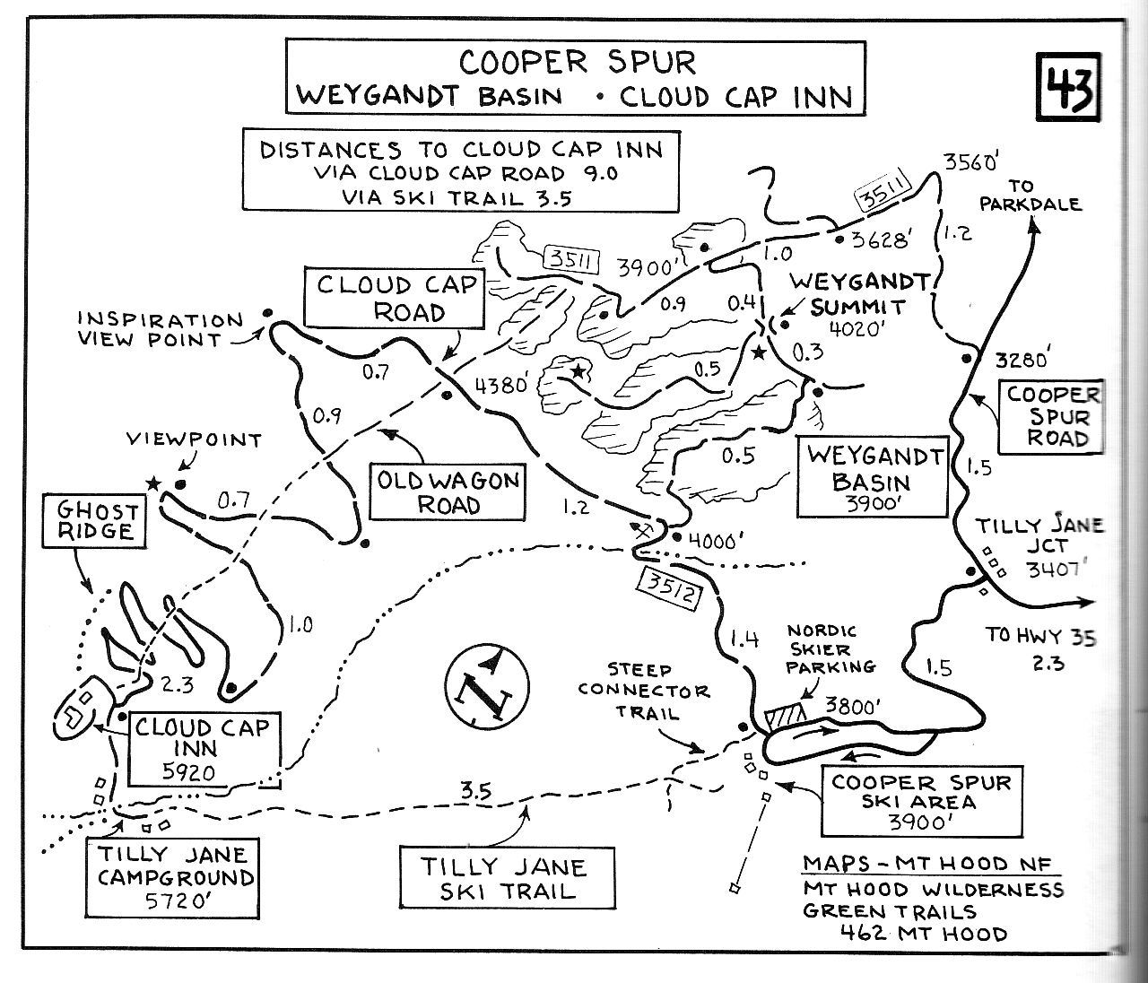
F
S

Slide 9
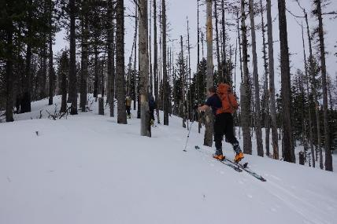
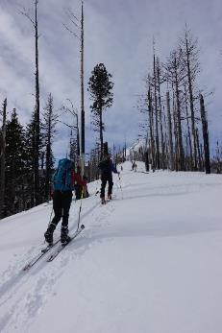
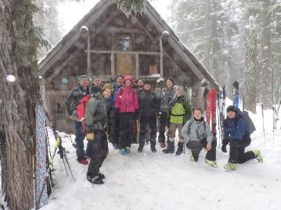
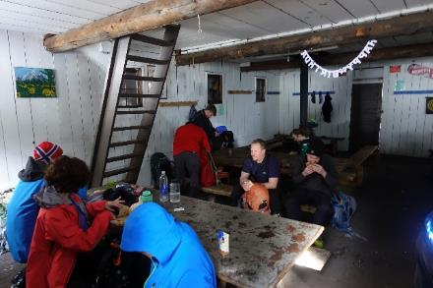
Detailed Route Info
We start at the Tilly Jane Sno Park at 3,800 feet and we climb up to 400 feet to 4,240 where we junction trail #643A - Polallie Ridge
We take to Polallie Ridge trail all they way up to the Tilly Jane A-frame
For the most part this section is pretty straightforward. You need skins as it is pretty steep but it is relatively straightforward.
The Gnarl ridge forest fire in 2008 burned though most of this area so it is not as scenic as much of Hood but as you get up higher we get our first glimpses of the mountain.
The snow on this section is usually pretty poor but don’t get too discouraged. Ghost ridge and the Old Wagon road on our way day generally has better snow.
After about an hour and a half of climbing we come up the Tilly Jane A-frame for a break. Usually there is a wood stove burning and we can rest in relative warmth
Climbing up with skins
Finally a view of Hood
Tilly Jane A-Frame

Slide 10
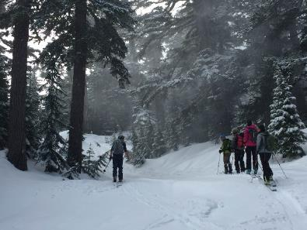
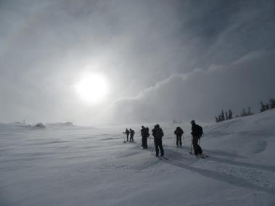
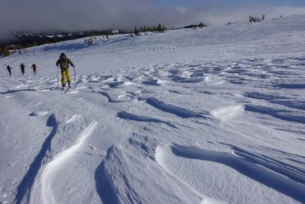
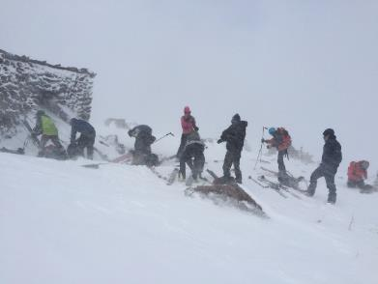
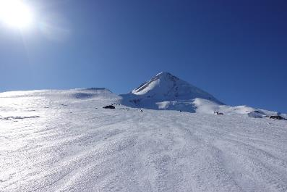
Detailed Route Info
After leaving Tilly Jane the route gets a little more interesting. We first wind our way along Polallie canyon and have some great views as it drops off to our left.
We are in the trees at this point but pretty soon we reach timberline and the trees thin out and they we are presented with some of the most scenic bowls on Mt. Hood.
Here we often enter the area of high winds. We’ll either feel the high winds ourselves or the snow will be pretty wind whipped.
We climb up until reaching the stone shelter
Skiing through trees above TJ
Surreal Bowls
Wind whipped snow
Stone Shelter on a tough day
Looking up at Hood

Slide 11
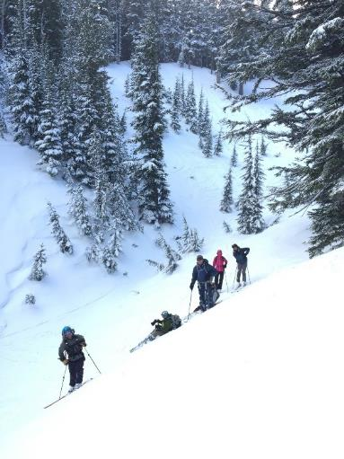
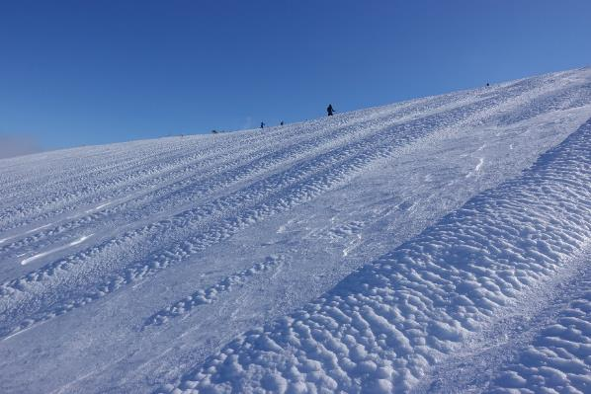
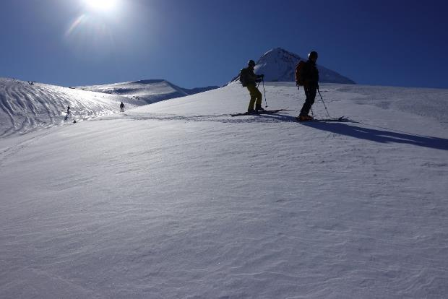
Detailed Route Info
We are finally ready to descend! Unfortunately, if you’ve come for great skiing you may be disappointed. The view is stunning but often the “snow” is miserable at this point. Think of sheets of ice.
We drop down into the gully just west of the stone shelter and work our way along what in the summer is the Timberline trail (trail 600). In some sense this is the crux of the tour. If we follow the right trail we can get good skiing all the way to Cloud Cap and not have to put skins on again
Usually as we get lower the snow improves
We finally make our way to the Cloud Cap Inn which is run by the Crag Rats
At this point the most technically difficult skiing is over.
Working through gullies
Surreal Bowls
Descending through wind whipped snow. Yuck

Slide 12
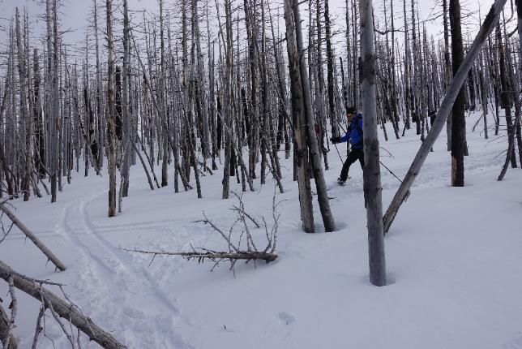
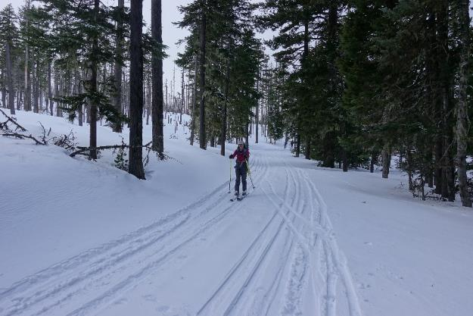
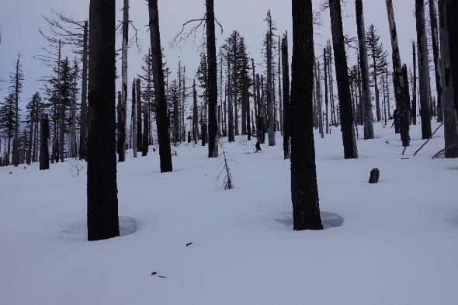
Detailed Route Info
Once we reach Cloud cap we now enter the main section of crossing and re-crossing the Cooper Spur road.
This section is Ghost Ridge or the old Wagon Road. It used to be that you were on a narrow path through here (Wagon Road) but with the Gnarl fire in 2008 this is pretty open and you get to choose your route down (provided there is enough snow to cover all the trees)
The terrain is not as steep and the snow is not wind whipped so this is often pretty good skiing.
We do however have to cross through some thick sections of trees. I haven’t worn a helmet in the past but it might be appropriate.
Finally we cross the road at ~4,200 feet and cross country ski back to the cars.
Tight Tree skiing
Good open skiing through the trees
Last stretch on the road

Slide 13
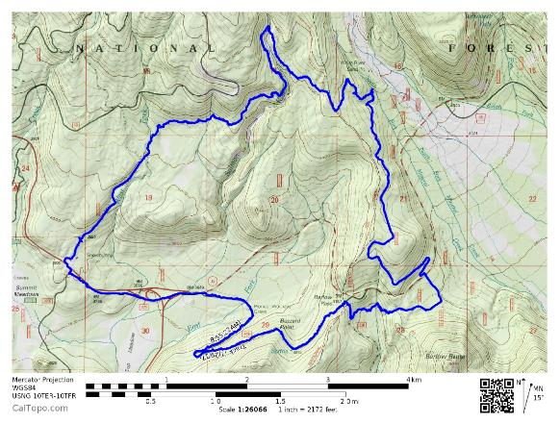
GPS Map Link (you are not required to bring a GPS but I’m making this available)
GPS Track on GPSies
The link above allows you to easily download a GPX file or you can use their iPhone app
GPS Track on CalTopo
The link above allows you to easily print a map of our route
Sample map from CalTopo

Slide 14
Background Info

Slide 15
ONC Carpooling Policy
If we don’t have drivers, we don’t have a trip. If you have a snow compatible car then please offer to drive. If we don’t have enough drivers then we’ll do a lottery to see who goes.
For passengers, the ONC policy is each passenger contributes 15 cents per mile. For three or more passengers, the maximum total contribution by all passengers is limited to 45 cents per mile. A typical round trip distance to Mt Hood and back is 120 miles to 160 miles = $18-$24/person

Slide 16
ONC Ski Rating
Novice level
These tours are for the inexperienced skiers. While this is not a lesson, the leader will help new skiers as much as possible. Tour length is 3-5 miles over nearly flat terrain.
Beginning/Easy level
4 to 6 Miles over gentle terrain at a pace comfortable for all participants
Intermediate level
6 to 12 miles. Terrain flat to long hills that are no steeper than found on a road (maximum 10 degrees). Moderate pace. Trail turning skills required, if there are hills.
Advanced level
> 12 miles. Terrain flat to steep hills (> 10 degrees). Moderate to fast pace. Strong turning skills required on the tours with steeper slopes.

Slide 17
What to Bring/Gear (click links below for more info)
Ski Rental Options
What to Wear
Tour Essentials
Chocolate for trip leaders.
Note that if you need to rent skis you’ll need to rent them prior to the trip. It takes quite a while to rent and it doesn’t work to split the group and try and regroup when renting on the way

Slide 18
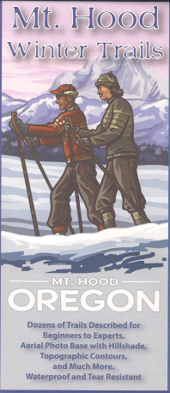
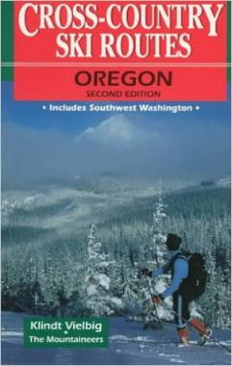
Maps/Guides
There are always new trails being developed and the maps I have images for are not the most recent. Therefore, please consider these maps to be a rough guide at best.
If you want to buy your own maps for this trip then the best one I’ve found for Mt. Hood is the 2015 Mt. Hood Winter Trails (BuyBetterMaps, Amazon or your local REI)
The best overall reference books is still Klindt Vielbig’s. This is out of print but you can still find used copies on Amazon

Slide 19
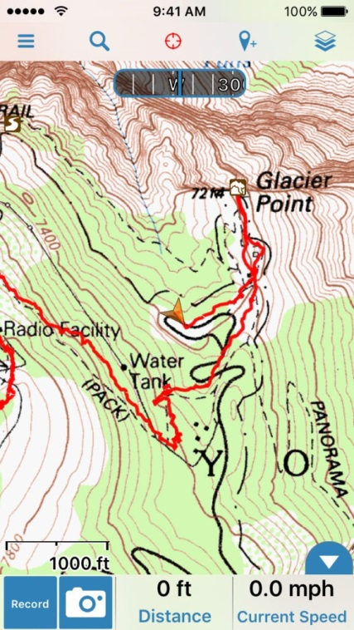
Electronic Map/GPS
I’ve given up carrying paper maps and instead use my smartphone to see the track and where I am
Numerous smartphone GPS apps are available, my own favorite is Gaia ($20).
See me at one of the club meetings if you need some help using this.
Sample screen shot for
Gaia iPhone Software

Slide 20
Weather Reports
Obviously the tour gets cancelled if we don’t have enough snow. Additionally if it looks like it is just going to rain on us all day then we’ll cancel. I like to use the following site to check the weather.
National Weather Service Zone Forecast. Good general description and snow level info.
Mount Hood WebCams. Amar Andalkar does a great job at pulling together all the WebCams. For day tours I like to look to see how much snow there is in Government Camp
Northwest Avalanche Center – Not applicable to the vast majority of ONC tours (since we rarely ski on or across slopes steep enough to avalanche)

